Slide 1

CSE 591
Computer Visualization
Milestone 2
Jiaqi He, Ersi Zha, Yezhuo Zhu

Slide 3
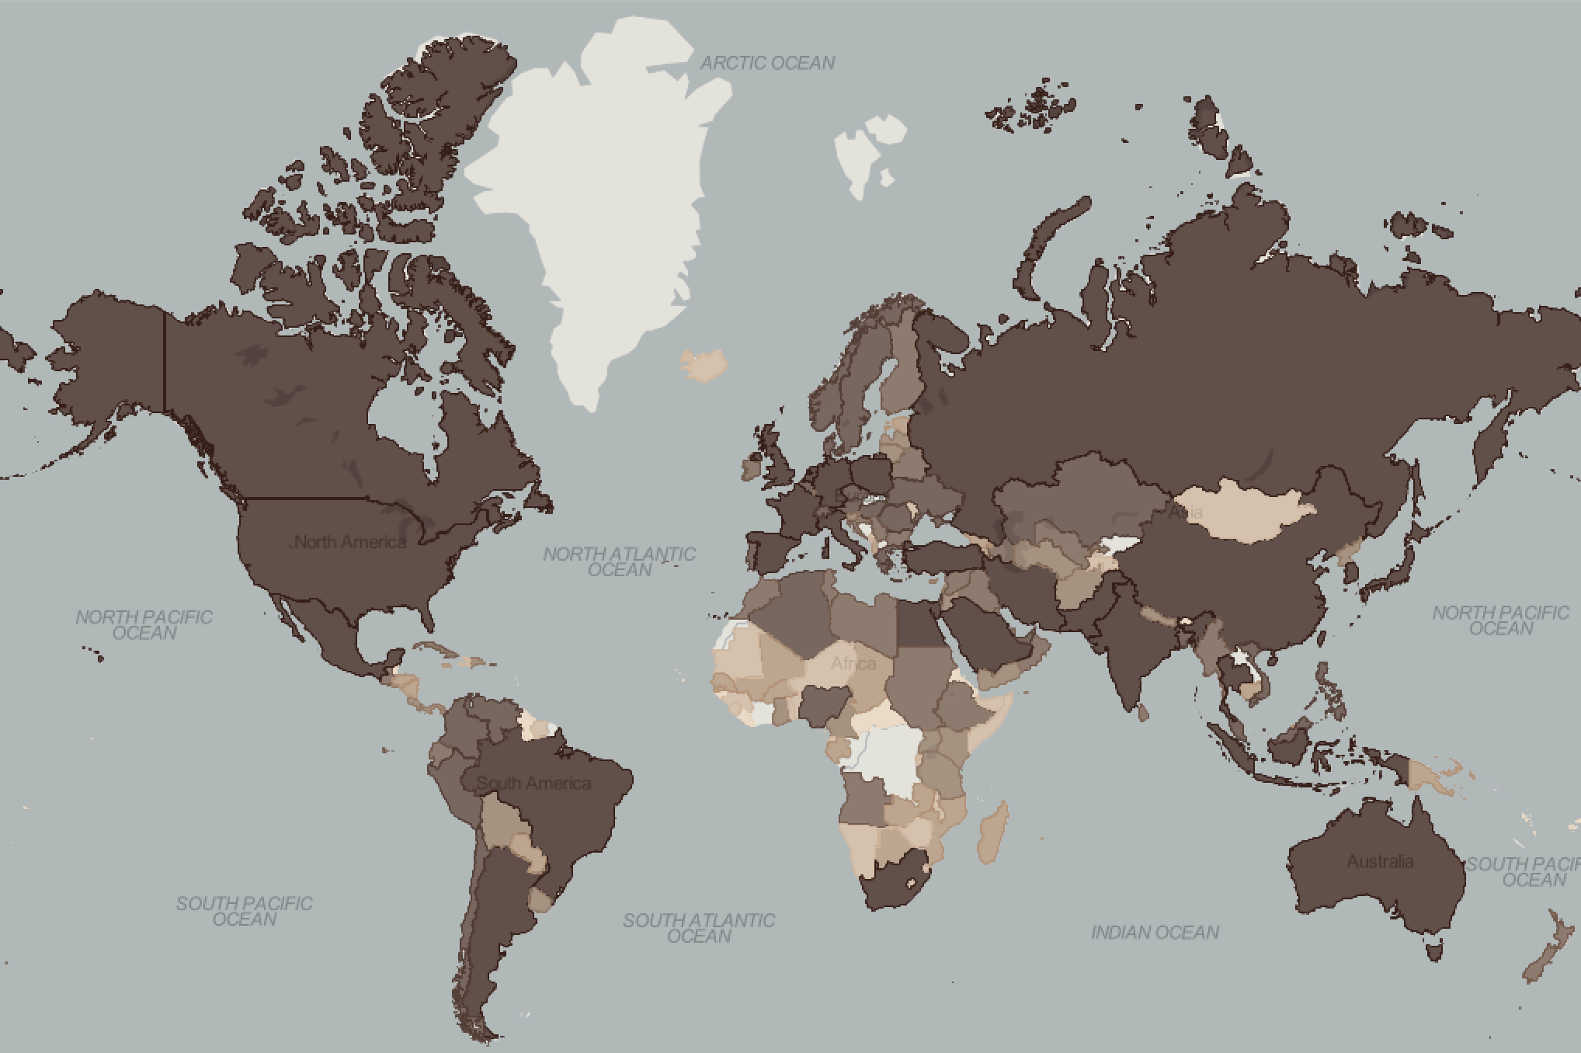
Visualization Ideas:
Choropleth Maps of GDP
An overview of global GDP

Slide 4
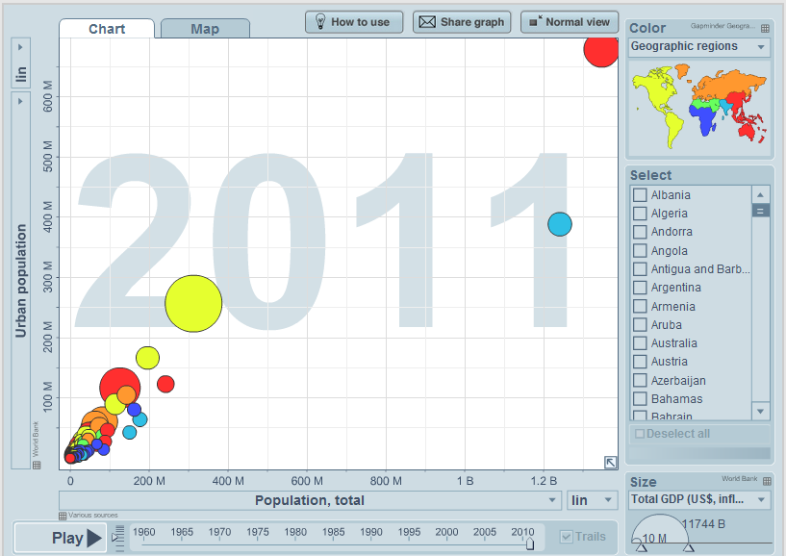
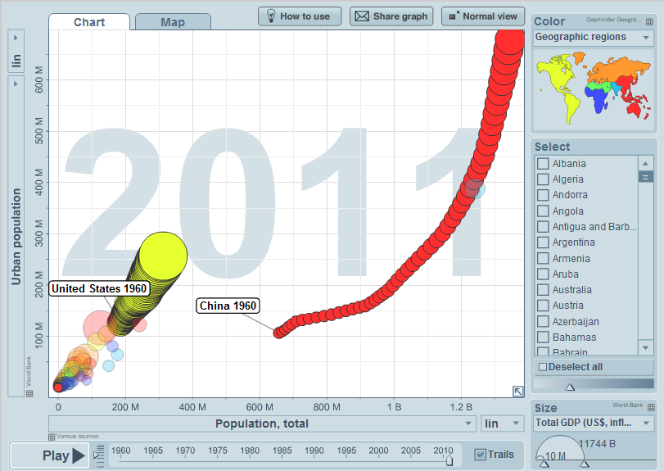
Bubble Plot Of Pouplation
X-axis: Total Population Y-axis: Urban Population
You can click here to see the demonstration.

Slide 5
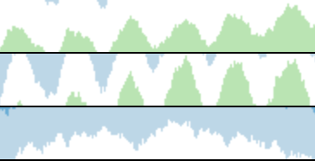
Poverty Stream River
X-axis represents time
Above X-axis: Income share held by highest 10%
Blew X-axis: Income share held by
lowest 10%

Slide 6
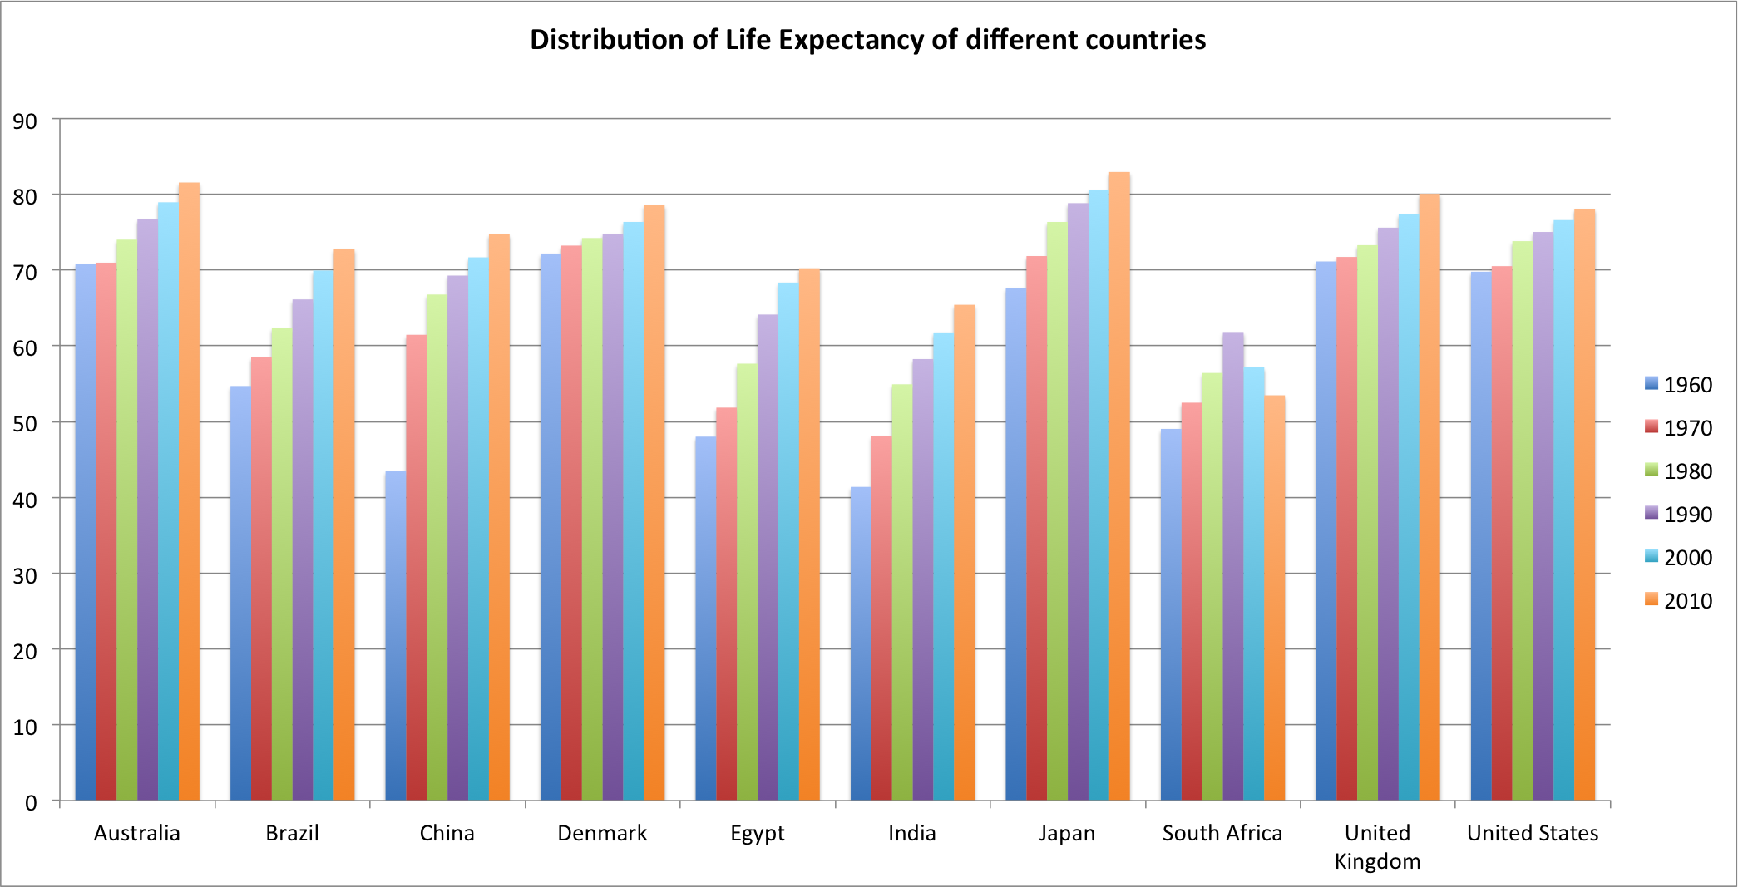
Histograms Of Health
e.g. Compare the Life Expectancy of 10 major countries

Slide 7
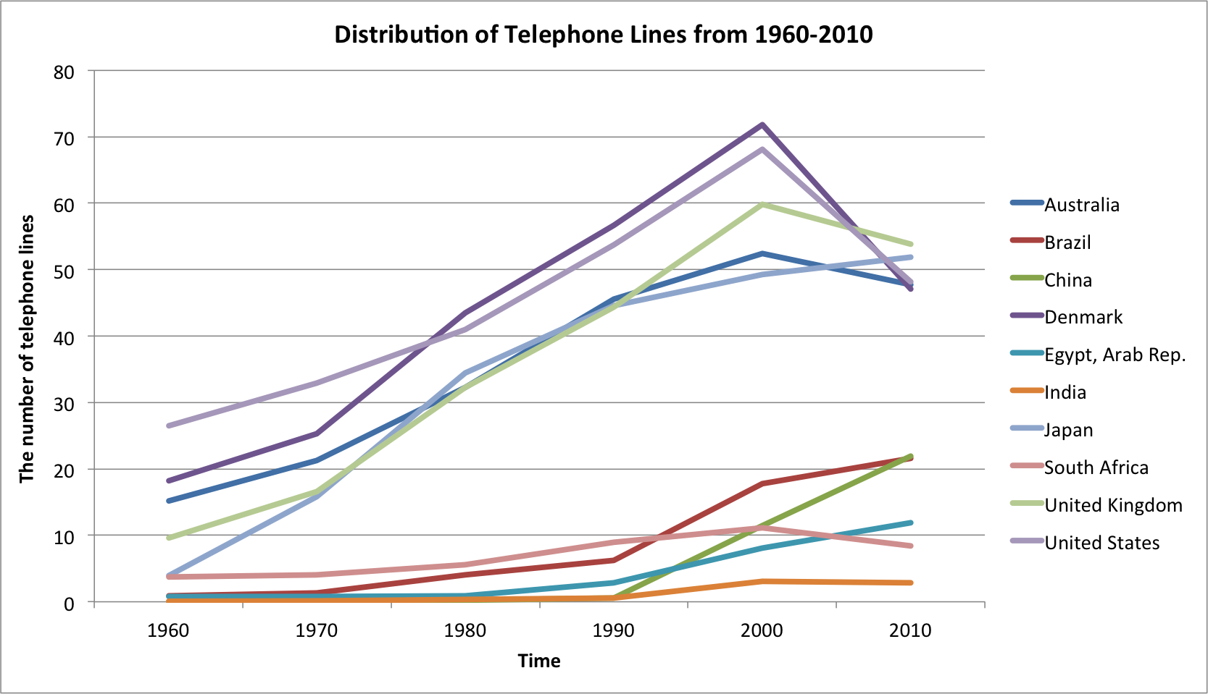
Line Chart of Infrastructure
e.g. Compare the number
of telephone lines of
different countries of
different years

Slide 8
A summary of our work
What we have done:
Downloaded and collected data from WorldBank Organization
Selected interested categories we are going to analyze
Used various visualization method to show dataset
In the next:
We will focus on the detailed implementation of visualization
We will learn how to use JS and other technologies to display these visualizations in web environment

Slide 9
Thank you!!!

